Slide 1


Mobile Recharge Testing….
U.Nanda kumar reddy
192111339
CSA3732
Software testing
for android applications

Slide 2
CONTENTS
TITLE
OBJECTIVE
ABSTRACT
PROPOSED SYSTEM
FLOW CHART
CONCEPT MAP
NO. OF TEST CASES
APP TOOLS AND INSTALLATION
IMPLEMENTATION TESTING SCREENSHOTS
TETST CASE OUTCOMES
TEST SCENARIOS
CONCLUSION

Slide 3
OBJECTIVE
Test the mobile recharge by implementing practical , efficiency and cost
Functionality checking using Appium software

Slide 4
ABSTRACT
Online Mobile Recharge is a web-based application developed in ASP.NET to recharge mobile phones. The project focuses at providing an easy and reliable platform to recharge mobile of any telecocoman company through online without buying recharge card.
The registered users of the system can recharge their prepaid mobile phones from anywhere at any time.The proposed project for recharging mobiles developed to automate the mobile recharging process.It roots out the manual card system of recharge and introduces a new and genuine online recharge process.
The online mobile recharge system is beneficial to both the admins and users. Using the online application, the admin can add new operators, tariff plans, offers and update or modify the existing tariff plans. It helps the users in creating their account, and then recharging the mobiles phones at any time.

Slide 5
PROPOSED WORK
To develop the testing environment, Appium software is installed in the windows and Intellij is an another software, a JDK , which provides us environment to run the java programs.
For visualization, android studio is installed.
To determine whether the application performs as per the requirement under different load conditions.
To determine whether the current network coverage is able to support the application at peak, average and minimum user levels.
To determine whether the existing client-server configuration setup provides the required optimum performance level.
The functionalities that are involved in the online recharge system involves below :

Slide 6
Login to application with valid username and password.
enter mobile no.
check weather it is valid or not.
enter recharge amount
for that check recharge plan.
check do you have required balance in your account or not.
generate OTP.
proceed to payment option.
send amount deduction message.
send recharge successful message.

Slide 7
FLOW CHART
START
NO
Login your web browser
RETRY LOGIN
YES
Select prepaid or postpaid
Enter mobile number
Select your plan
Enter the amount
Proceed for payment method
Amount deduction message and recharge successful
END

Slide 8
CONCEPT MAP
Features to be tested
Software used
Quick processing
Android studio
- software used for visualization
24x7 services
MOBILE RECHARGE
TESTING
Appium
Secured transaction history
Intellij
-software used to run java programs
Multiple payment option
Working robotically
Appium
Open source
automation tool
Security
Software used for testing application
Allows to automate different mobile application

Slide 9
TEST CASES
Login to application with valid username and password.
enter mobile no.
check weather it is valid or not.
enter recharge amount
for that check recharge plan.
check do you have required balance in your account or not.
generate OTP.
proceed to payment option.
send amount deduction message.
send recharge successful message.

Slide 10



APP TOOLS
ANDROID STUDIO
IntelliJ
APPIUM
STUDIO

Slide 11
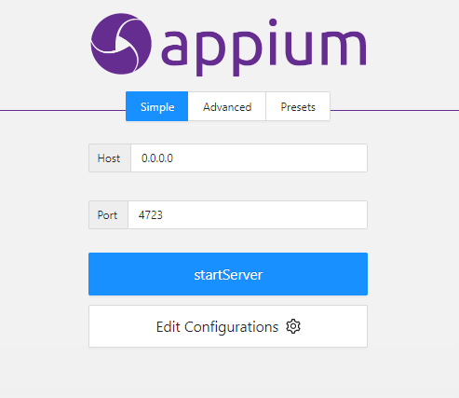
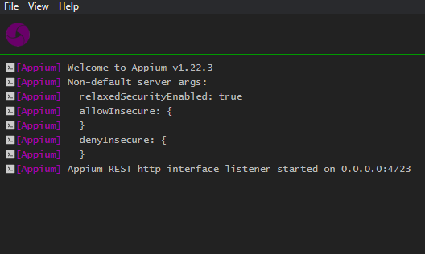
APPIUM SERVER
BEFORE STARTING SERVER
AFTER STARTING SERVER

Slide 12
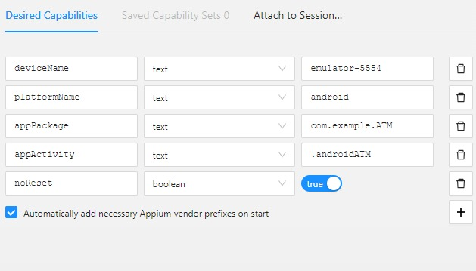
IMPLEMENTATION & TESTING SCREENSHOOTS
Give the Desired Capabilities in Appium Inspector.
It will start the session and gives you java code to start testing.
Paste the code in IntelliJ IDE and Start the Testing.

Slide 13
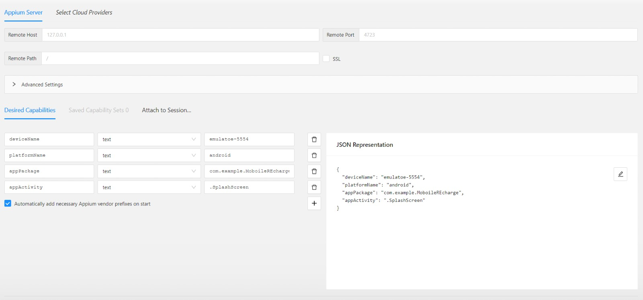
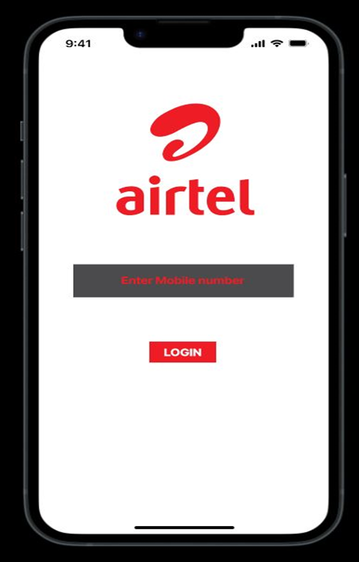
IMPLEMENTATION OF TESTING
IMPLEMENTATION OF TESTING

Slide 14
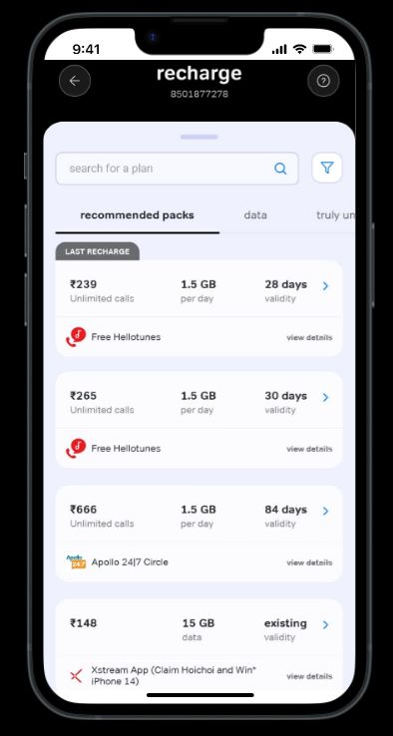
IMPLEMENTATION OF TESTING

Slide 15
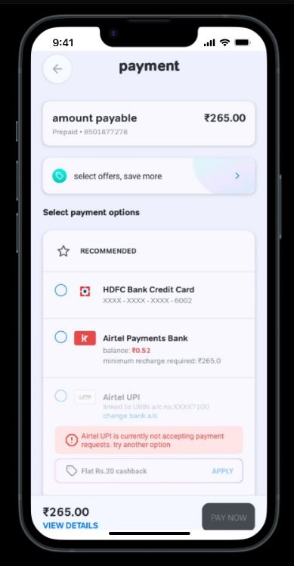
IMPLEMENTATION OF TESTING

Slide 16
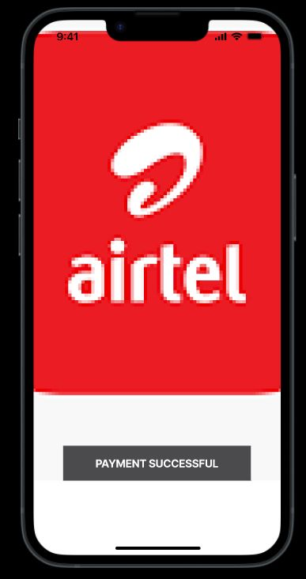
IMPLEMENTATION OF TESTING

Slide 17
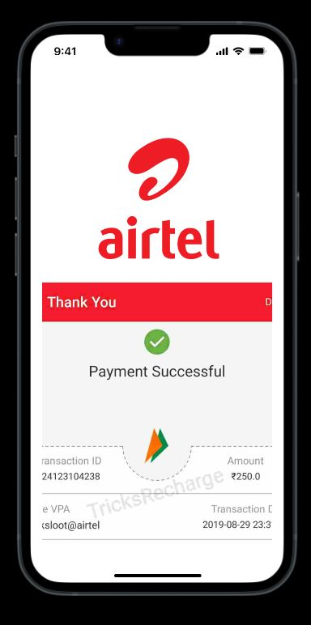
IMPLEMENTATION OF TESTING

Slide 18
TESTCASE OUTCOMES
TEST CASES | POSITIVE/NEGATIVE
Enter valid email or mobile no. | positive
Enter invalid mobile no. | negative
Click on submit button | positive
Select the valid recharge plan | positive
Enter recharge amount | positive
Check required balance in account | positive
Generate OTP | positive
Enter invalid OTP | negative
Proceed to payment option | positive
Enter invalid payment amount | negative
Payment deduction message | positive
Payment successful message | positive

Slide 19
CONCLUSION
This project has been developed successfully and the performance of the system has been found satisfactory. Use of this interface helps customer in having immediate information about available recharge tariff and do recharge without wasting their precious time. User friendly Interface also for the admin to add and delete tariff information.

Slide 20
THANK YOU

